Slide 1
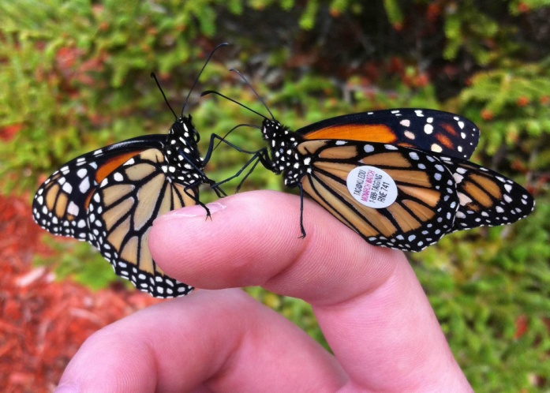
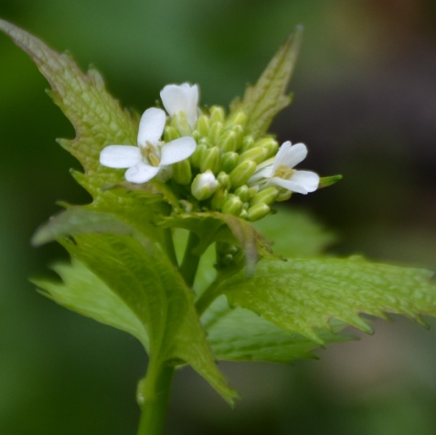
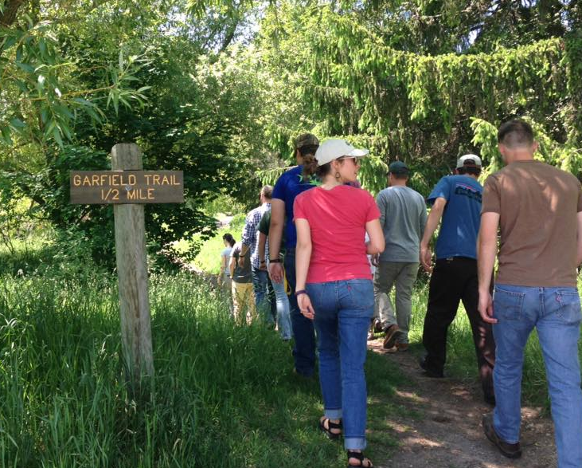
Invasive Species in
Northwest Michigan

Slide 2
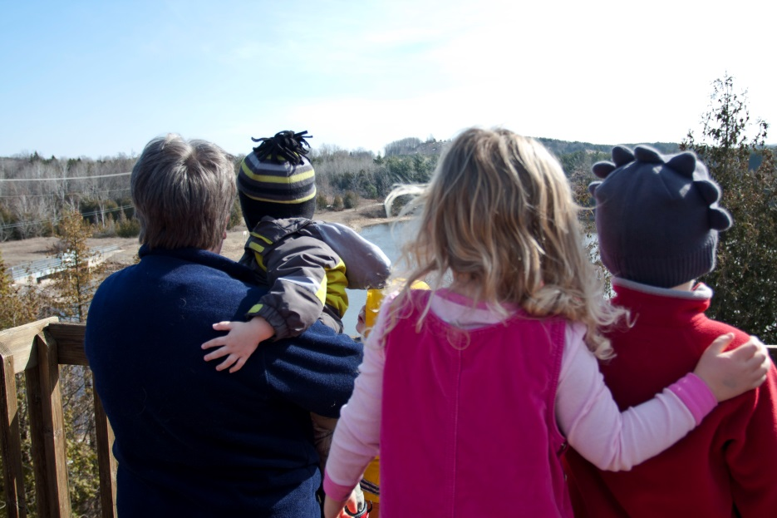
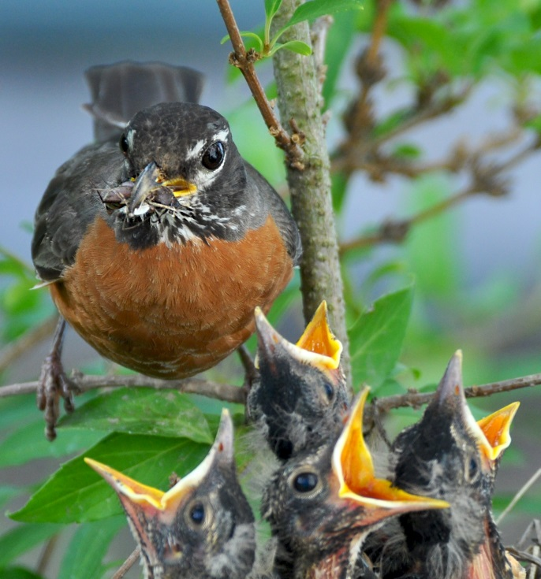
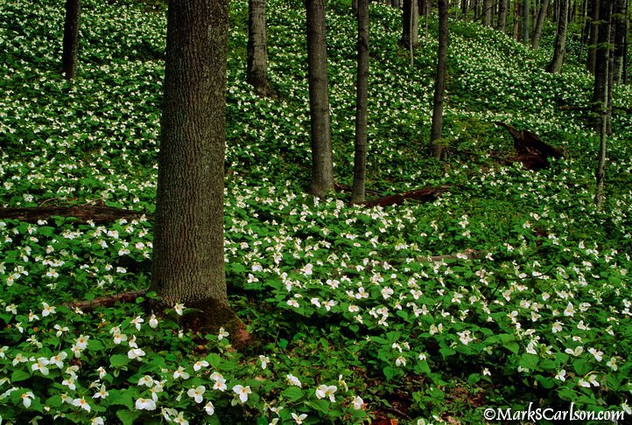
Habitat Matters
Notes:
On a basic level, we care about invasive species and their proper management because habitat matters. These images break down the reasoning to three main categories.
1. Habitat matters for people – northwest Michigan is known for its stunning beauty, unique coastal dunes, and unique recreational opportunities. Invasive species have the ability to change that landscape, in turn affecting our own enjoyment of the area. 2. Habitat matters for a successful economy – this area is becoming an ecotourism mecca and similar to how invasives can affect our own enjoyment, tourists would also be impacted by a change in landscape and travel opportunities. (i.e. Depleted forests, lakes with minimal access due to infestation of aquatic plants.)
3. (Potentially most important) Habitat matters for wildlife – plants serve as the foundation of a complicated food web. When those relationships are changed, everything higher on the web are impacted. As invasive plants enter an ecosystem and impact the natives, pollinators are affected which in turn hurts birds and so on and so on. We need wildlife to live and we use a lot of them!

Slide 3
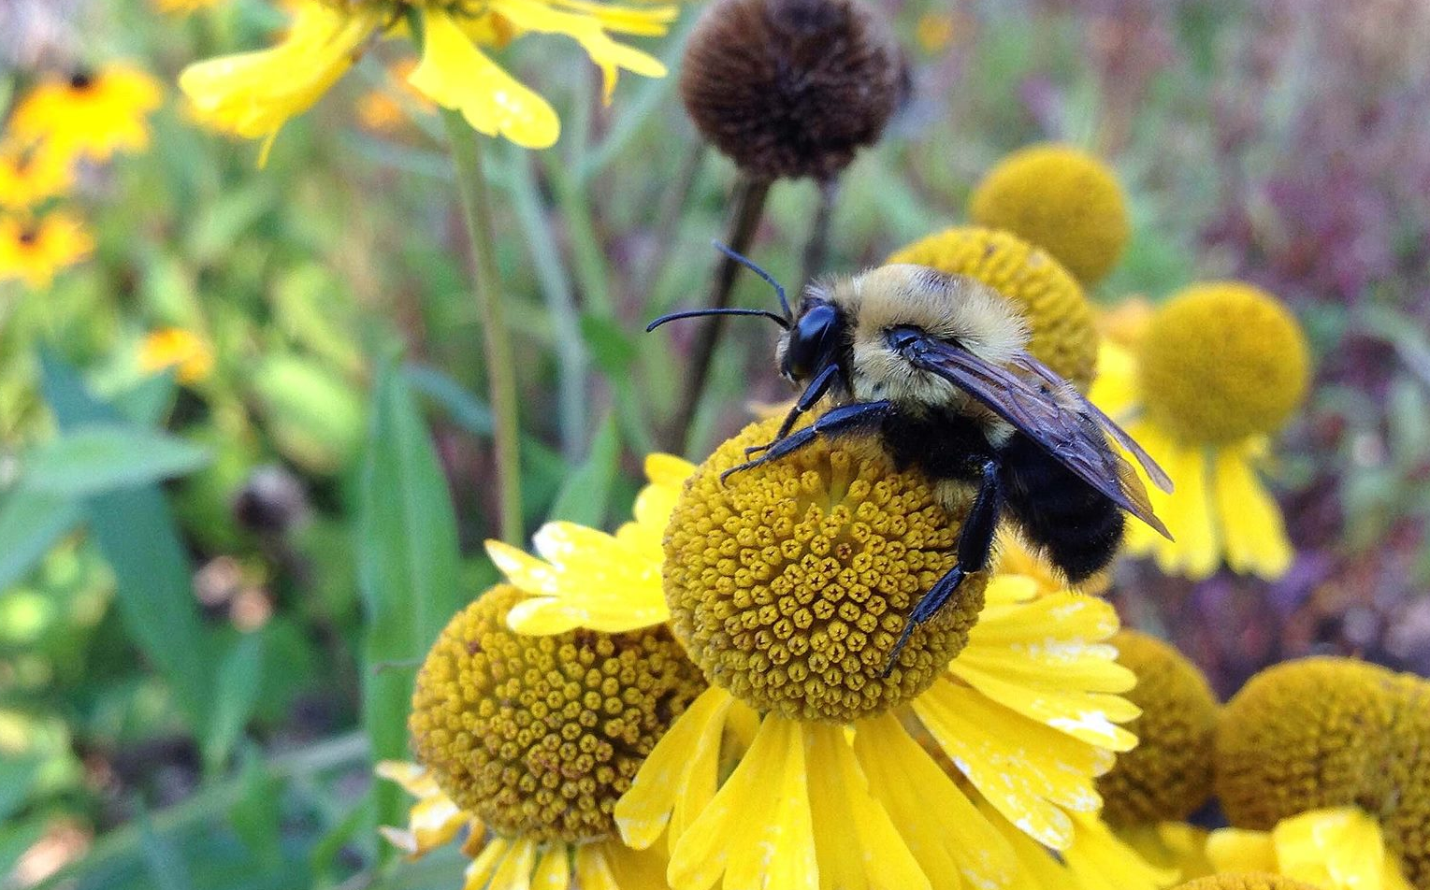
Notes:
These images provide perfect examples of why native plants are so important and how much the introduction of an invasive species can affect pollinators. Monarch caterpillars rely on a single type of plant to survive – milkweed. (Above photo shows them resting on joe-pye weed.) With an increase in habitat loss due to development and over-crowding by invasive species, milkweed numbers are depleted which greatly affects the monarch butterfly population. Additionally some invasive plants pose a bigger threat! Black swallow-worts, for example, are members of the milkweed family but monarch caterpillars cannot eat them. For some reason, female monarchs will lay their eggs on the swallow-worts, even if milkweed plants are growing in the same field – the reasoning for this is unknown. When the eggs hatch, there is no food source available causing the caterpillars to die.
Bees are the more commonly recognized pollinators but often less respected! They are crucial to the success of not only native wildflower populations but our own food supply. Heathy, diverse, and native habitats are imperative to their success.

Slide 4
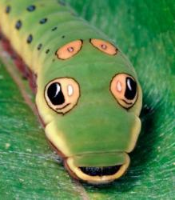
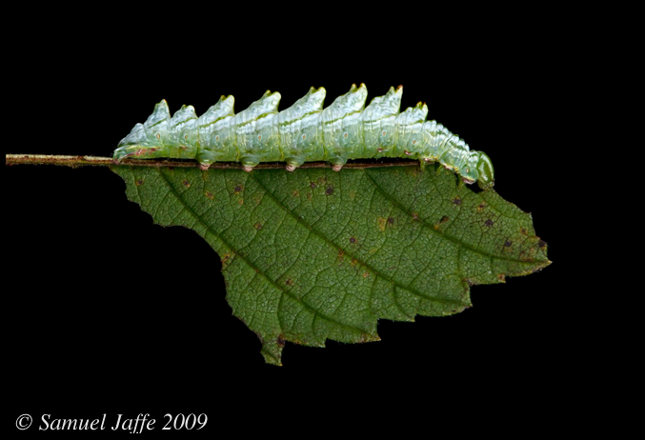
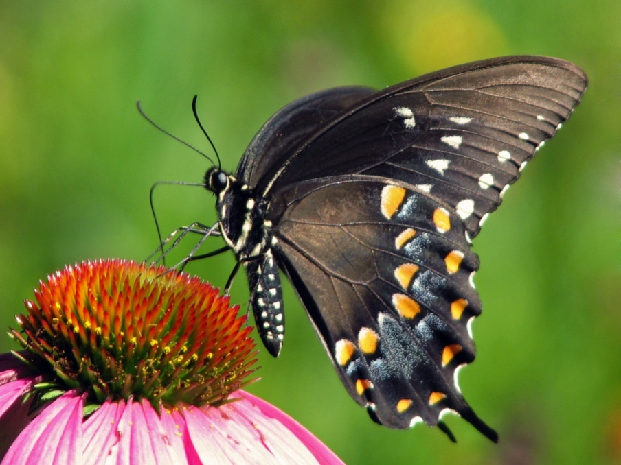
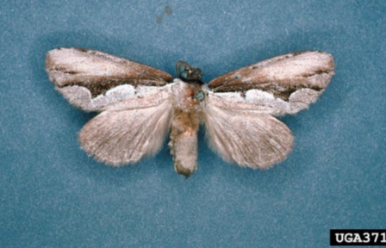
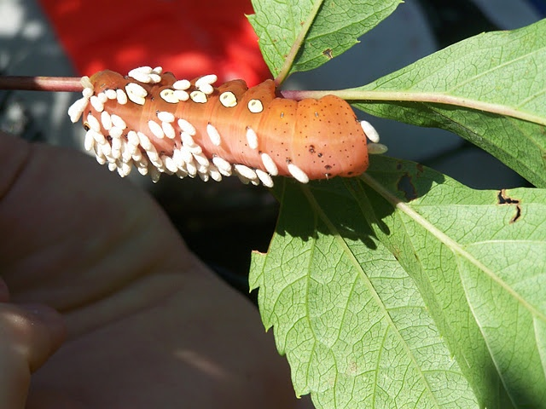
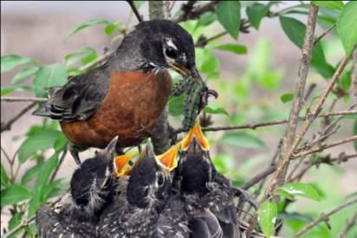
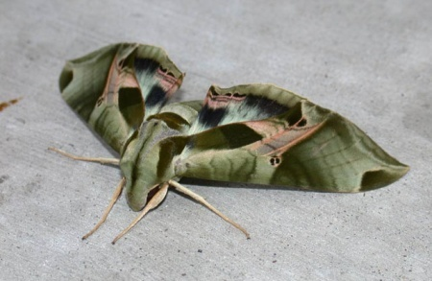
Nature’s Vast, Unseen World
Northern spicebush swallowtail. Hosts: spicebush, sassafras.
Lisa Brown
Double-toothed prominent (Nerice bidentata) on an elm leaf.
Pandorus sphinx moth
(Eumorpha pandorus) on a Virginia creeper at Kids Creek Park.
Carol Groves
Notes:
Source: Tallamy, Doug. Bringing Nature Home: How You Can Sustain Wildlife with Native Plants. Timber Press, 2007.
These are some other great examples of native plant—native insect partnerships, beyond the monarch butterfly. (Fun fact: the sphinx moth is actually covered in wasp larvae, taking natural relationships a step further!).
Why should we care about a healthy insect population? Birds! Baby birds rely on nutrient-dense insects and grubs – they cannot and won’t consume seed at such a young age.

Slide 5
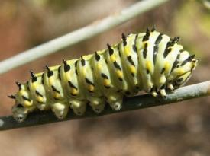
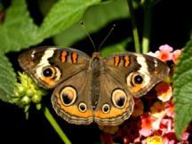
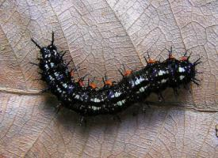
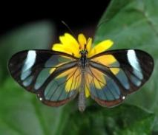
Nature’s Vast, Unseen World
Woody Plants Ranked by Ability to Support Butterfly/Moth Species
Common Name | Genus | Species Supported
oak | Quercus | 534
willow | Salix | 456
cherry, plum | Prunus | 456
birch | Betula | 413
elm | Ulmus | 213
pine | Pinus | 203
chestnut | Castanea | 125
Source: Tallamy, Doug. Bringing Nature Home. Timber Press, 2007.
Notes:
This slide and the next depict the incredible difference between native and invasive plants and the organisms they support. The numbers shown here are ONLY butterflies and moths and it is quite astounding that a species (and associated sub-species) of tree can support hundreds of insects. This example fits perfectly within the existing discussion on needing native plants to serve as the strong foundation of a large and diverse food chain.

Slide 6
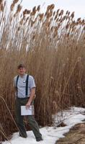
How Long Until “Non-Native” Becomes “Native?”
How long does change take?
Hosting Capacity of Alien Plants Introduced to North America
Plant Species | Herbivores Supported in Homeland | Herbivores Supported in North America | Years Since Introduction to North America
Black sally | 48 species | 1 species | 100
Melaleuca tree | 409 species | 8 species | 120
Indian fig cactus | 16 species | 0 species | 250
Invasive phragmites | 170 species | 5 species | 300+
Invasive Phragmites
Source: Tallamy, Doug. Bringing Nature Home. Timber Press, 2007.
Notes:
Invasive Phragmites is the plant listed on this chart that is prevalent throughout Michigan and frequently targeted locally – although it is important to note the other numbers as well. Much like our own native species, invasives often have a higher ecological purpose in the part of the world where they originated. They evolved to support their own organisms. However, when moved to a new area, they support very few (especially when compared to the numbers from the previous slide!). Some may argue that the plants simply have not been here long enough to become established for native herbivores. Unfortunately, that reasoning does not stick with plants such as Phragmites. Having been here for more than 300 years, it still only supports about 5 species.

Slide 7
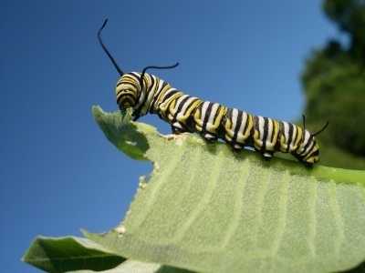
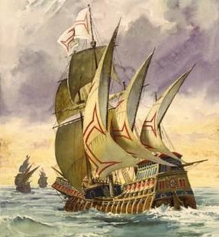
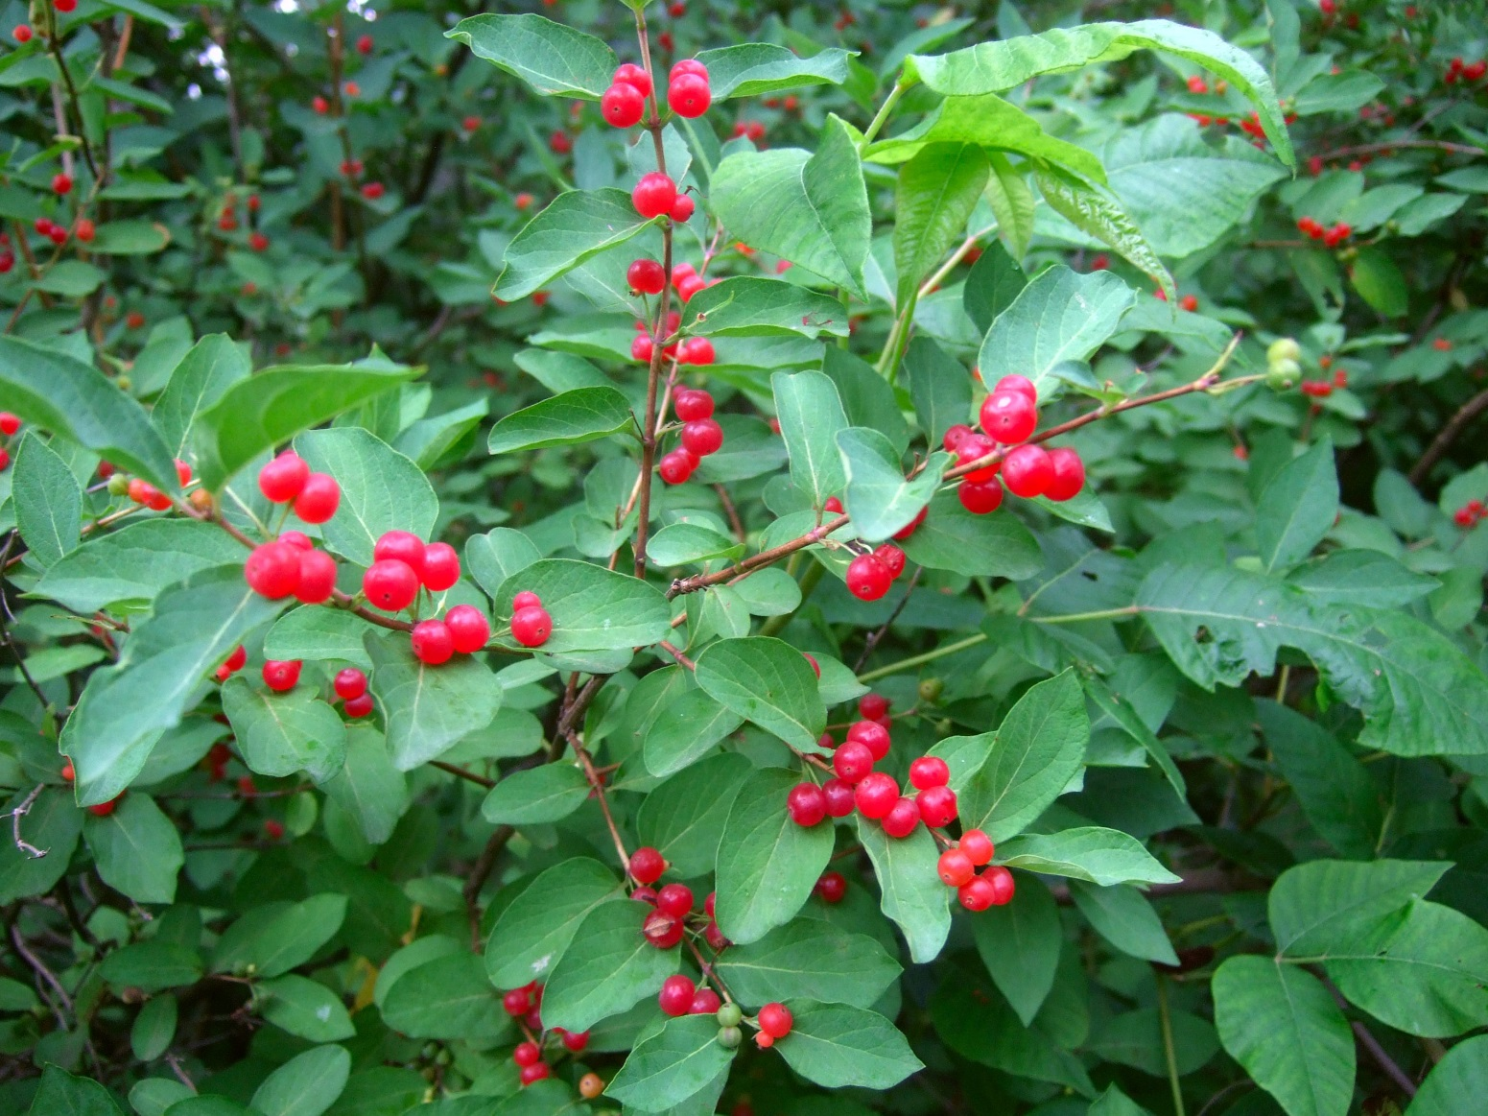
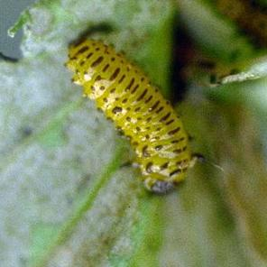
What’s Invasive?
Non-native
Massive seed production
Few natural predators
Invasive honeysuckle
Jake Hendee
Native monarch caterpillar eating native milkweed leaf
Agriculture and Agri-Food Canada Archive, Agriculture and Agri-Food Canada, Bugwood.org
Purple loosestrife beetle introduced for biocontrol
Wolfgang Meinhart
Frankenstoen, Bugwood.org
Notes:
A lot of people use the term “invasive” without knowing exactly what that means. Here is a breakdown of invasive qualities:
Non-native: The plant (or animal) was introduced from another part of the world, whether that was Europe, Asia, or elsewhere. Some plants are irritating to us or seem to take over in places (poison ivy, for example) but because it is originally from Michigan, it is not considered invasive.
Few natural predators: There is nothing to keep an invasive species “in check” once it arrives in a new location. No native insects feed on the foliage and no other animals consume the plant, allowing it to spread quickly. Some invasive species, like garlic mustard, taste bad to deer while others are outfitted with thorns (Japanese barberry).
Massive seed production: Invasive species are able to reproduce at a faster and more prolific rate than many natives. Shown is a honeysuckle which contains thousands of berries. Invasive baby’s breath is known to have more than 14,000 seeds on a single plant. And the list goes on. Additionally, many invasive plants have extensive root systems which allow them to spread even further.

Slide 8
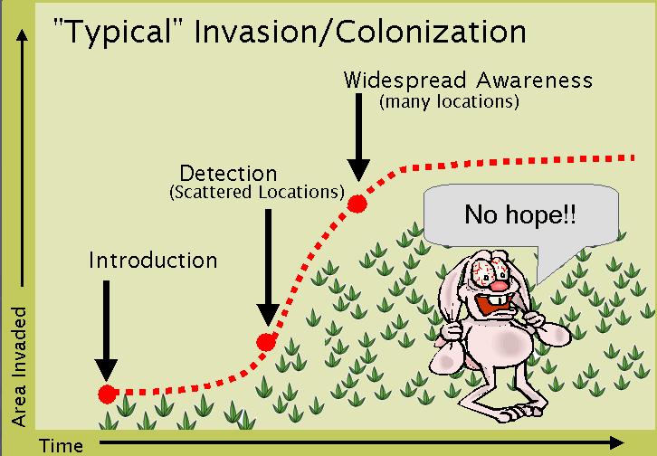
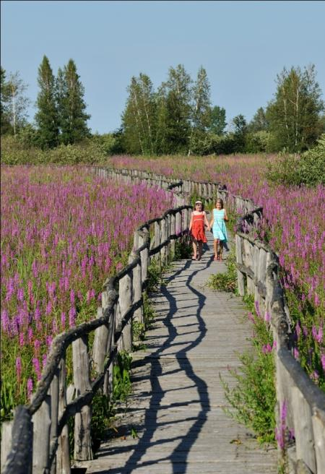
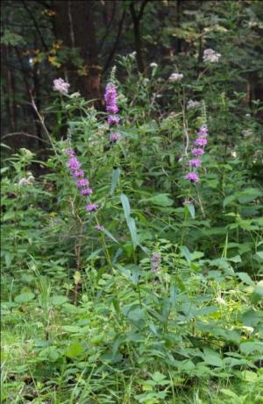
What’s Invasive?
Formal definition – a non-native species that harms people, the environment,
or the economy.
Jörg Hempel
Ellen Jacquert
Source: Michigan Natural Features Inventory
Saffron Blaze
Environmental harm – a natural area consisting mostly of one or a combination of introduced plants that provide minimal habitat value.
Notes:
Note the formal definition of invasive species.
Trivia: How much does the United States spend annually on invasive species (including management, prevention, education, etc.)? Approximately 13 billion dollars.
When it comes to identifying an invasive species and managing it, it is crucial to act early, before people, the environment, or the economy are harmed. First image on right shows a single purple loosestrife plant which is relatively easy to manage. As soon as a plant spreads, it takes more money and more human-power to get it under control and successful management is less successful. (Flip to next image). For example, once purple loosestrife gets to a point where it has completely overrun a landscape, the task is much more daunting than it could have been if detection and management had occurred immediately.

Slide 9
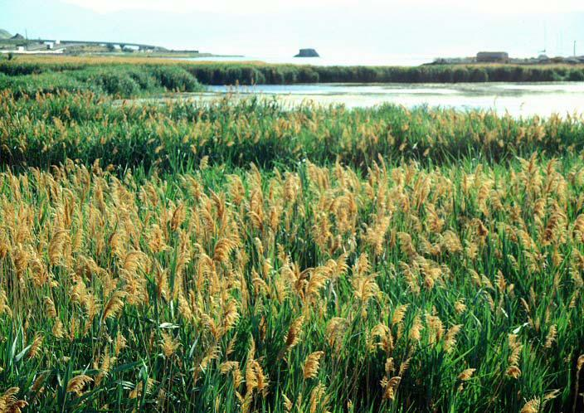
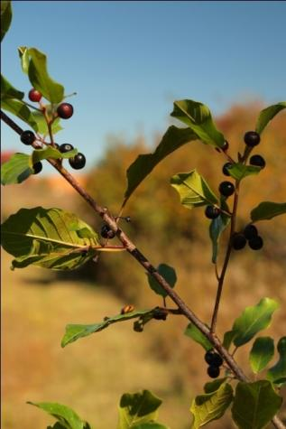
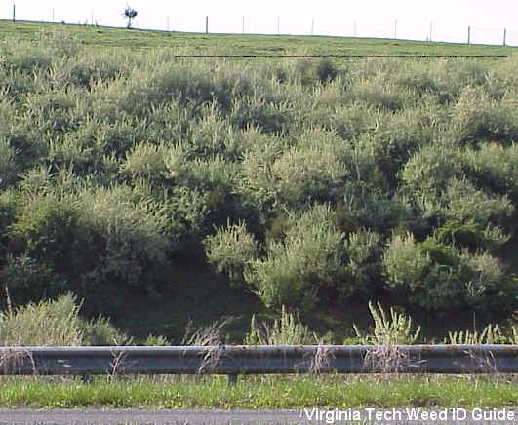
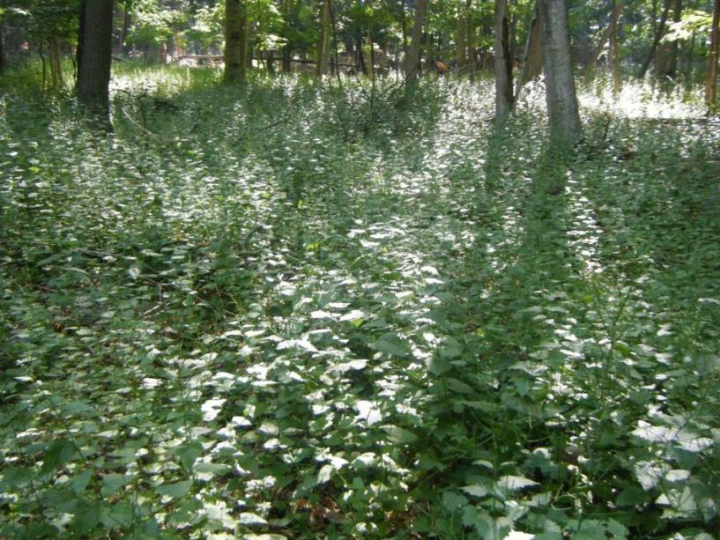
How Do They Get Here?
Imported accidentally
Invasive Phragmites
Imported for gardens
John M. Randall, The Nature Conservancy, Bugwood.org
Planted to manage soil erosion
Buckthorns
Mark Lindsay
Imported for food or medicine
Autumn olive
Garlic Mustard
Grand Traverse Regional Land Conservancy
Notes:
So, how do invasive species get here in the first place?
Imported accidentally
Example: Phragmites
Some are simply brought over on accident. Phragmites for example was believed to have been brought over as a packing material in ship ballast. There were no regulations for what plant material could and could not be moved 300 years ago.
Imported for gardens
Example: Buckthorns, Japanese barberry, Myrtle
50% of invasive plants are from gardens and many are still sold. While they often make good landscape features, invasive species rarely stay contained within a garden. Some spread via roots and creep into neighboring natural areas while others are have berries/seeds which are transported via wildlife.
Planted to manage soil erosion/create habitat
Example: Autumn olive
Other invasive species are here because they were planted intentionally before anyone knew the impact they would have on an area’s ecology, a “conservation oops”, if you will. Autumn olive is a perfect example. Planted to manage soil erosion and to provide wildlife habitat, it has now spread nearly beyond control, thriving in open fields, along forest edges, and next to lakes and rivers. Conservation Districts actually sold this plant to landowners in the 80’s and 90’s as a conservation tool. Now, efforts are being made to get the plant under control which is proving to be a major challenge.
Imported for food or medicine
Example: garlic mustard
Before modern medicine and developed cuisine, people relied on some invasive species for their basic needs. Garlic mustard was used as a salad green and provided a good source of several vitamins. Eventually, better options, like basil, came along and garlic mustard was allowed to escape cultivation and spread.
Trivia: All parts of a garlic mustard plant can be consumed.

Slide 10
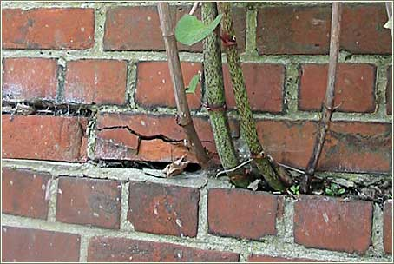
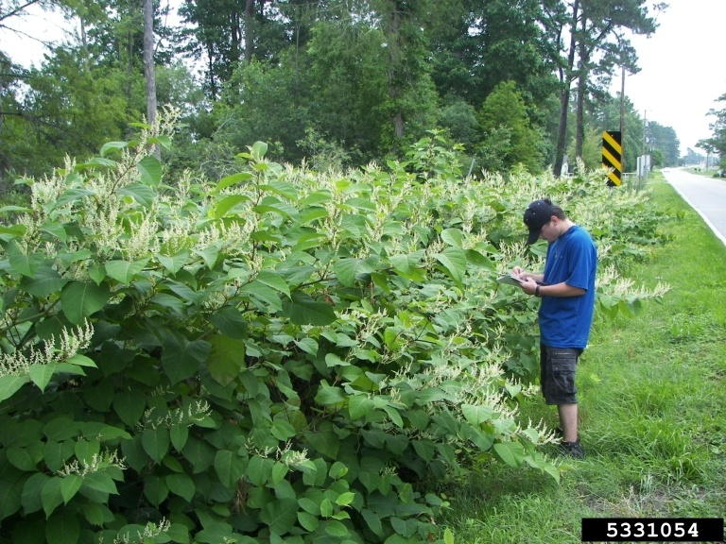
Japanese knotweed
Polygonum cuspidatum (Fallopia japonica)
Native to Asia
Introduced as an ornamental
Illegal in Michigan
Problems:
Displaces native species
Difficult to control
Can damage property
Traditional uses: food, medicine.
Buyabetterhome.co.uk
Bradley Kriekhaus, USFS
10-12 feet tall
Often called “Michigan bamboo”
Randy Westrbooks, USGS
Notes:
Japanese knotweed is considered a priority species in northwest Michigan. Introduced from Japan, it evolved to grow through hardened lava meaning its roots are incredibly strong and long. They even have the ability to grow through concrete –meaning our roads and homes are at risk. Originally brought over as a garden ornamental it is now illegal to move or sell this plant in the state of Michigan, although many people still have existing populations on their own property. Because this plant can grow to be so huge (10-12 feet tall) and very, very dense, knotweed easily crowds out native species. Additionally, treatment is problematic. A fingernail-sized portion of the plant can form a new population. This means that any cutting, mowing, dumping, etc. simply spreads knotweed. The Invasive Species Network and similar organizations recommend chemical treatments for proper, successful management.
Note: Japanese knotweed is often mistaken for bamboo because of it’s size and the appearance of the segmented stalks.

Slide 11
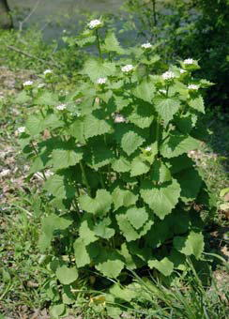
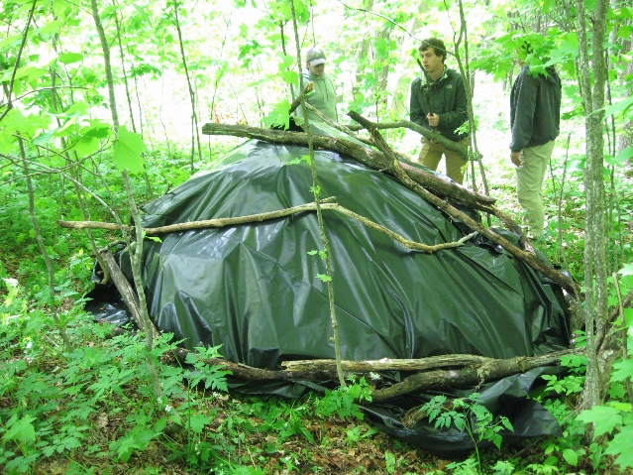
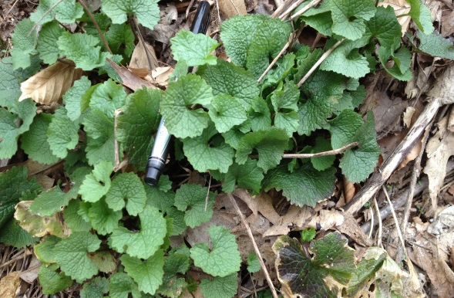
Garlic Mustard
Alliaria petiolata
Native to Eurasia
Introduced as a food source
Problems:
Displaces Natives
Competes with tree seedlings
Unpalatable to most native herbivores
Disposal options:
Find a use
Dumpster
Tarping
Chris Evans
Traditional uses: food, papermaking, animal feed
Katie Grzesiak
Notes:
Garlic mustard is another priority species. Originally introduced as a food source, the plant escaped cultivation and now readily spreads into available habitats, easily outcompeting native species. Not only does garlic mustard form dense stands, but it is also allelopathic meaning its roots release a chemical that inhibits the growth of other species which may be trying to grow nearby. It is very shade tolerant which is another provides another advantage over native species. Often found in forests, garlic mustard easily out-competes tree seedlings. This can affect the entire regeneration of a forest ecosystem. Unfortunately, there are no known predators to keep garlic mustard in check. As its name suggests, the plant is quite strong in flavor. Deer have been known to take a bite and then spit the plant out.
Unlike Japanese knotweed, garlic mustard is easily pulled out of the ground. However, it cannot be left on site – further disposal needs to take place. Some people enjoy the taste of garlic mustard and it can still be used as a food source. (Scraps should all be bagged and taken to a landfill.) Many people opt to bag the plant and landfill the large quantities that have been removed. Additionally, another option is tarping which involves smothering pulled plants for an extended period of time. The above image on the right shows this method taking place. However, the tarped garlic mustard needs to be monitored and many times this process take multiple years to be successful.

Slide 12
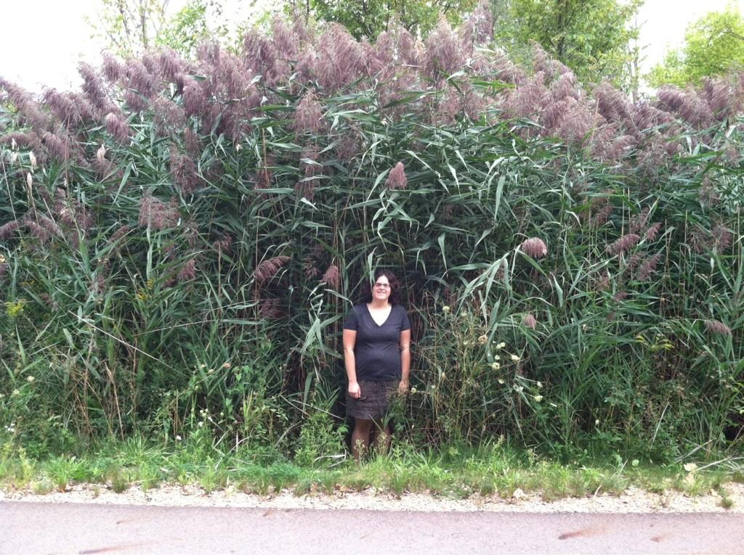
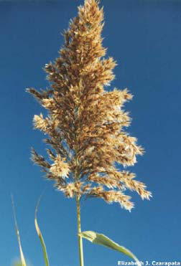
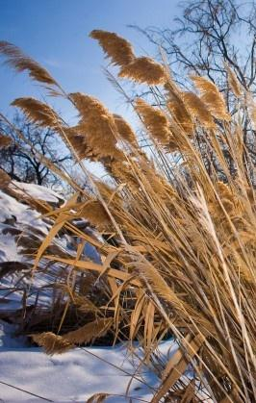
Invasive Phragmites
Phragmites australis
Native to Europe
Introduced accidentally
Problems:
Displaces native plants
Decreased property values
Increased fire risk
Can reach up to 15 feet tall
There is a native phragmites
Notes:
Like other invasive species, Phragmites displaces native plants. In the top photo, you can see why. It can grow extremely tall and dense. Unlike the previously mentioned species, Phragmites is an emergent plant meaning it grows in the wet areas alongside bodies of water or in other wetland spots. Because of this, it can also greatly affect fish habitat. Additionally, because of it’s great height, people have seen decreases in their property values. When Phragmites grows to its maximum height on a shoreline, views and access points are disrupted. Beyond the ecological and economical harm, Phragmites can also lead to an increased fire risk. Dead and seasoned stalks, when packed in such a dense manner, can easily cause a rapid-burning fire. However, under controlled situations, this is also a method for removing remaining stalks after a plant as been chemically treated. (When a plant is chemically treated, the remaining stalks remain on-site and dry out. Burning is one method for removing that dead bio-mass.)
It is important to note that there is also a native Phragmites. It looks very similar but in general, is much less robust. It grows less densely and the seed heads are smaller. When in doubt, certain parts of the plant can be measured to confirm identification.

Slide 13
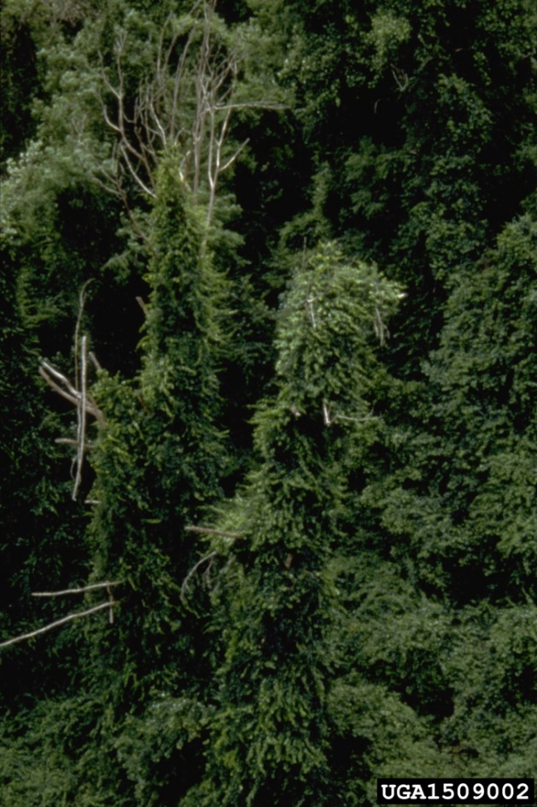
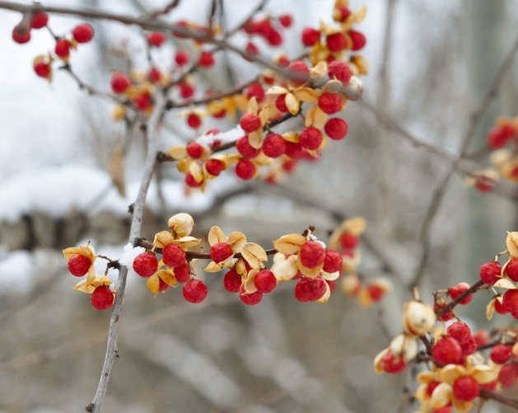
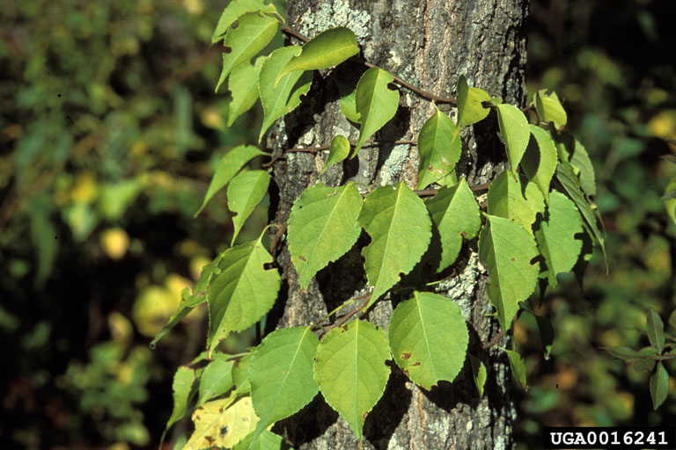
Oriental bittersweet
Celastrus orbiculatus
Native to Asia
Introduced as an ornamental
Problems:
Out-competes native American bittersweet
Shades out trees it climbs on
Max Williamson
Traditional uses:
native and introduced versions both used in fall crafts
James H. MIller
Steve Conaway
Notes:
We are fortunate to not have a lot of oriental bittersweet in northwest Michigan. However, it is becoming more prevalent in some areas, causing it to be a species of concern. Often used in holiday crafts, the many berries of oriental bittersweet are easily spread by birds and when moved from place to place by humans or forces of nature. Oriental bittersweet is different in that it is a heavy, woody vine which climbs trees. Instead of directly out-competing understory plants (which it can also do), bittersweet harms larger trees by completely overtaking the canopy. (See above, top photo.)
The native species, American bittersweet, looks quite similar but has elliptical leaves, rather than rounded. The berries also appear different.

Slide 14
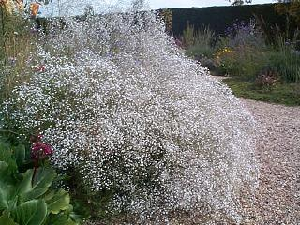
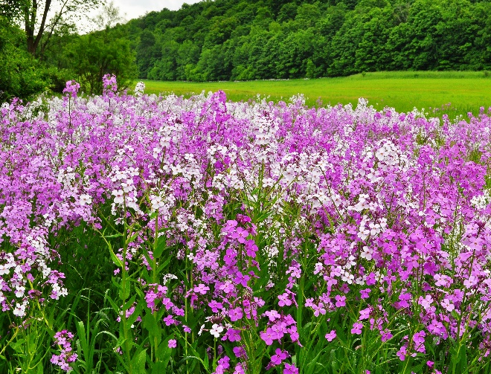
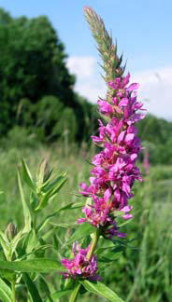
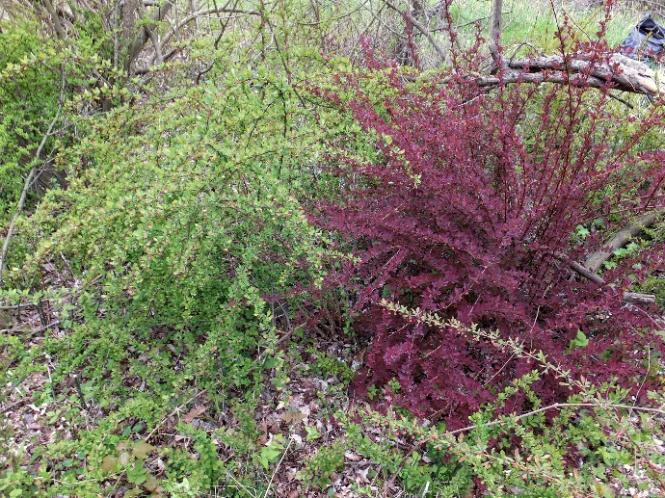
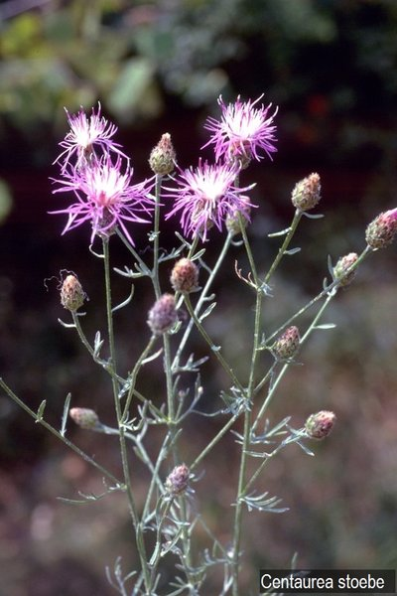
Other Inasive Species
Flower_mauays_nursery
Baby's breath (Gypsophila paniculata)
Dame's Rocket (Hesperis matronalis)
Purple Loosestrife (Lythrum salicaria)
Japanese Barberry (Berberis thunbergii)
Spotted Knapweed (Centaurea stoebe)
Notes:
Shown on this slide are a handful of additional invasive species that are commonly seen in northwest Michigan. These would be more commonly seen on an invasive species hike.
Baby’s breath – introduced as an ornamental and still sold in wildflower mixes. Grows primarily on sand dunes but can spread elsewhere, especially in sandy soil
Japanese barberry – also introduced as an ornamental and also still sold. Often sold in the burgundy color but can be green as well. Both colors are found in areas that have been infested. Barberry is thorny and known to harbor black-legged ticks.
Puple loosestrife – A restricted plant in the state of Michigan but still common enough to spot along wetlands and other bodies of water. A very vibrant purple. Loosestrife is often kept in check by biocontrol – beetles that only eat this plant are released and consume the foliage
Dame’s rocket – leaves and stem resemble garlic mustard but has white, purple, or pale purple flowers with four petals. This can often be confused with phlox which has five petals.
Spotted knapweed – Like garlic mustard, knapweed is allelopathic, releasing chemicals that hinders the growth of neighboring plants. An alternative name in “Star thistle” – given as a more appealing option because this plant is a favorite among bee-keepers.

Slide 15
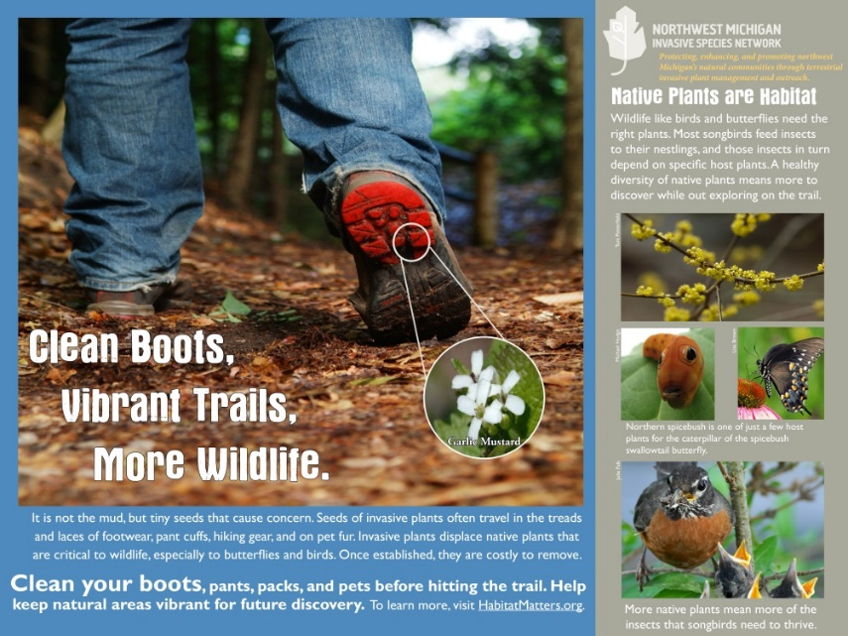
Ways to Take Action
Report (MISIN.msu.edu)
Stop the Spread
Clean off at trails
Don’t plant invasive ornamentals
Spread the word
Planting Guide
Get Involved – volunteer!
Notes:
Once someone is familiar with invasive species they can easily REPORT a finding online via the Midwest Invasive Species Information Network. Using your computer or phone’s app, a GPS coordinate is taken that allows plant information to be sent directly to invasive species professionals.
The easiest way to take action is to STOP THE SPREAD! Clean out the treads of boots and bike tires before leaving a natural area. This prevents any trapped seeds from being moved elsewhere. Also, don’t plant invasive species in your garden. Become familiar with what invasive species are still being sold and look for non-invasives or even better, a native!
Want to go a step further? SPREAD THE WORD. Head over to ISN’s website for a digital planting guide and send it to people who love to garden. Also, encourage students to tell others about what they have learned. Word of mouth and continuing education is critical to invasive species management.
GET INVOLVED. There are wonderful opportunities in this region for students who want to get involved in invasive species work. Single students or entire classes can join us at an event to gain hands-on management experience and to see how landscapes have been affected by invasive species – and how helping to manage the population is benefiting the ecosystem.

